Slide 1
Meeting September 24, 2024
Both MUT_Source and MUT_examples repositories have been updated
Examples have been run and there are some issues with a couple of them, described below.
The manual is a work in progress. It needs a few more days at least to fill in missing content.
Software distribution methods need review
I’m currently running the Visual Studio 2022 community version and a very recent Intel Fortran version

Slide 2
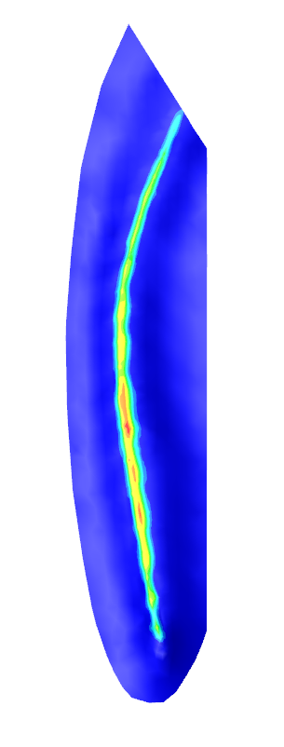
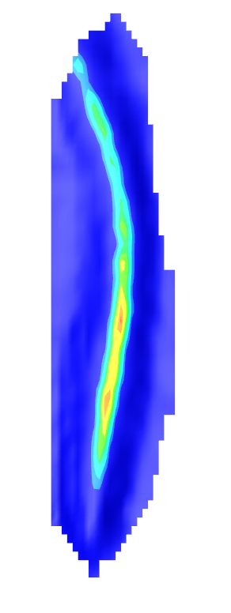
Example 6_Abdul_MODHMS
Meeting September 24, 2024
The example is mirrored in Y relative to our Abdul model
Is this from the original MODHMS data or is it an error in the elevation_MUT_001.dat file?

Slide 3
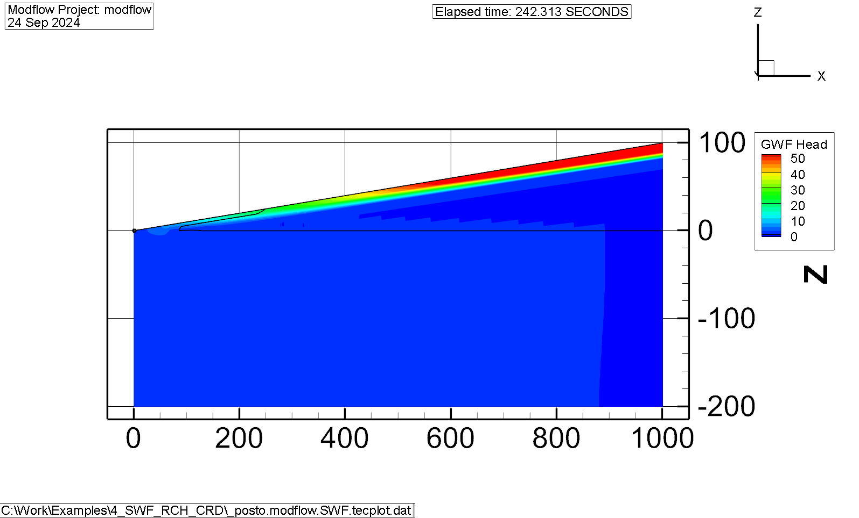
Example 4_SWF_RCH_CRD
My version isn’t set up right yet. Young-Jin: we need to check units, input values etc.

Slide 4
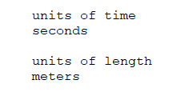
Units Instructions
Up to now MUT assigned seconds and meters as the default units with no user control
These instructions currently just define the definitions written to the .DIS file but could:
Be used to check input units e.g. if GWF database had a time and length units column for each record they could be converted as required.
Convert constants e.g. grav etc.

